Slide 1
Tutorial 2
Week 1 review and Assignment 1
Delivered by Jinghao

Slide 2
2 Modes of OS
When the CPU executes instructions, it is either in user mode or Kernel mode.
User mode runs application instructions
Kernel mode runs previlleged instructions (memory and device control)

Slide 3
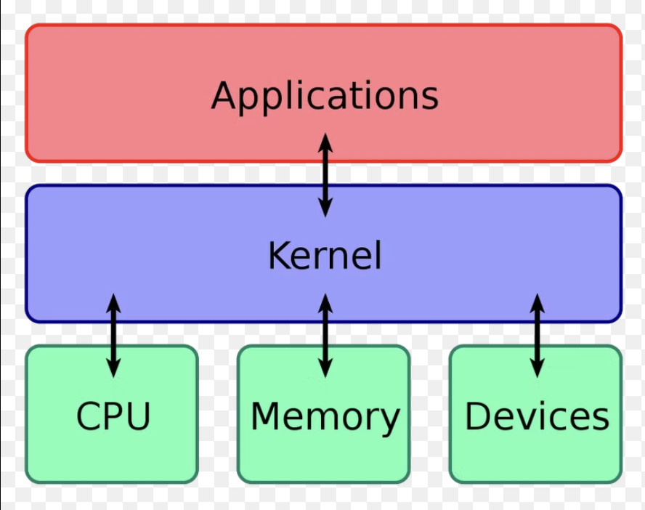
2 Modes of OS
To enter kernel mode:
System call (User request)
Exception (made by user; unexpected)
Hardware interrupt (worker request)
Why? The kernel is responsible to protect the os. Imagine allowing users to access and modify memory (hardwares) freely, the os will crash.
Think of a company, users are the customers and customers do not interact directly with the workers. A manager bridge between them

Slide 4


Trap (user —> kernel —> user)
Gives control to kernel
Previlliged Instructions
by kernel
User instruction
Save states
Process Control Block
(PCB)
Restore states
Control return to user

Slide 5
Files and file descriptors
“Everything can be treated as a file in unix or unix-like OS”
Integer to indicate resource held by a process. Here the resource could be a stdin (like keyboard), stdout (monitor)
Use for communication between process

Slide 6
Kernel structures
Monolithic: means single, everything handled by the kernel
Microkernel: reduced kernel previilege, gives user more control over the system

Slide 7
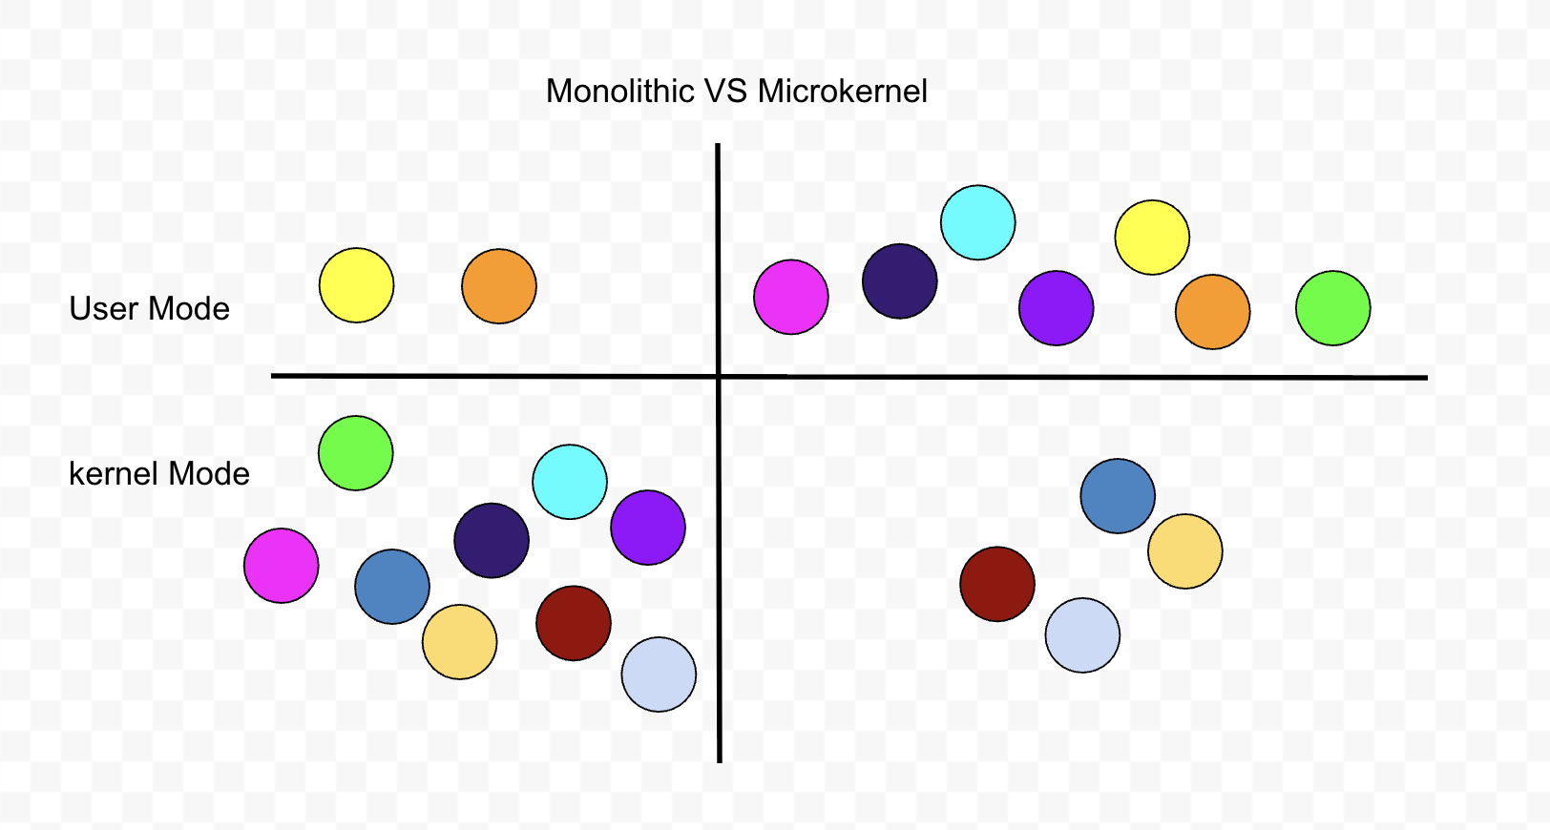

Slide 8
Attendance

Slide 9


Slide 10
Assignment 1
Rust version

Slide 11
Assignment 1 (flexit and Omnissa Horizon Client)
curl --proto '=https' --tlsv1.2 -sSf https://sh.rustup.rs | sh
rustup toolchain add nightly (ignore this if using flexit)
source $HOME/.cargo/env
Cd to target folder (before doing this, please clone the rust version of the assignment)
cargo build --release
qemu-img create target/fs.img 2G
./mkfs.sh
cargo run --release
Ctrl a then x to exit
cargo run --release to reboot
🙂

Slide 12
Part 1: Basic xv6 interactions
Implement system call touch
Write program to demonstrate use of pipe for communication between the parent and children process
Write program to demonstrate the use of fork to spawn child process from parent process
Write program to demonstrate the use of pipe and fork to filter all prime numbers within the range of a given parameter.
🙂

Slide 13
Part 2: replace/modify existing scheduler
Limit to 1 CPU only
Assign priority to process
Process run comply to priority
Scheduling algorithm to break priority tie (Round Robin)
🙂

Slide 14
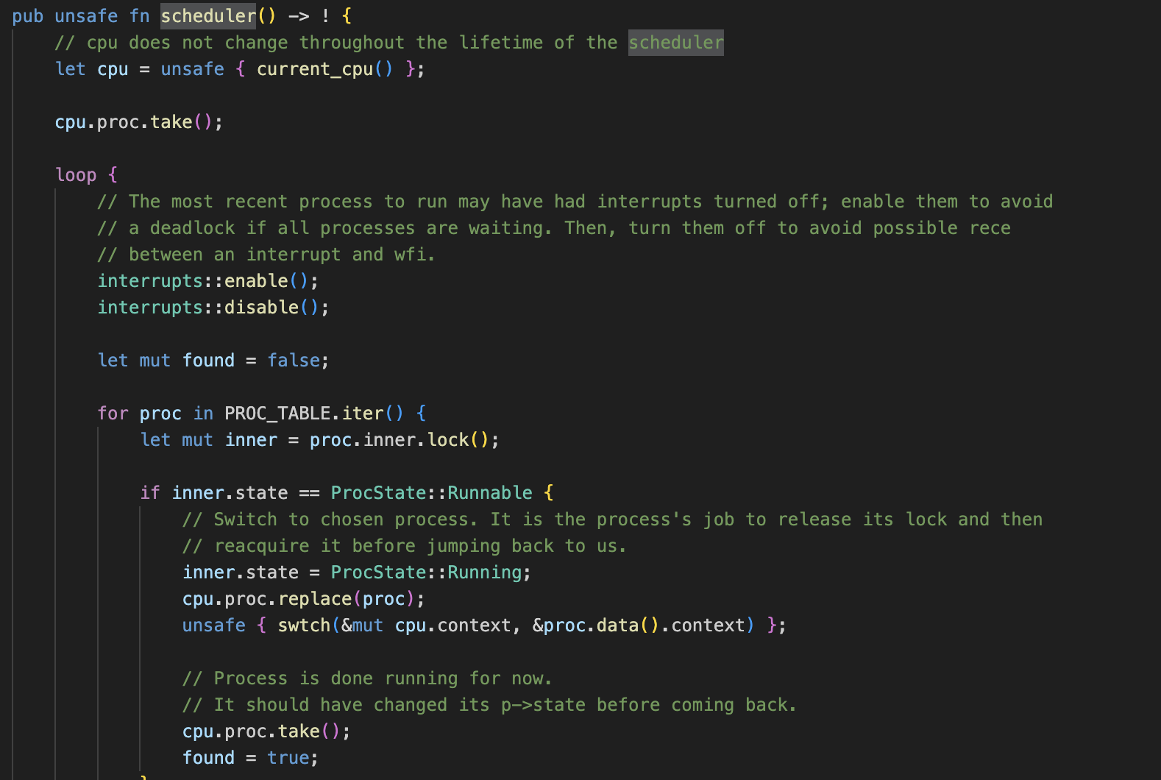
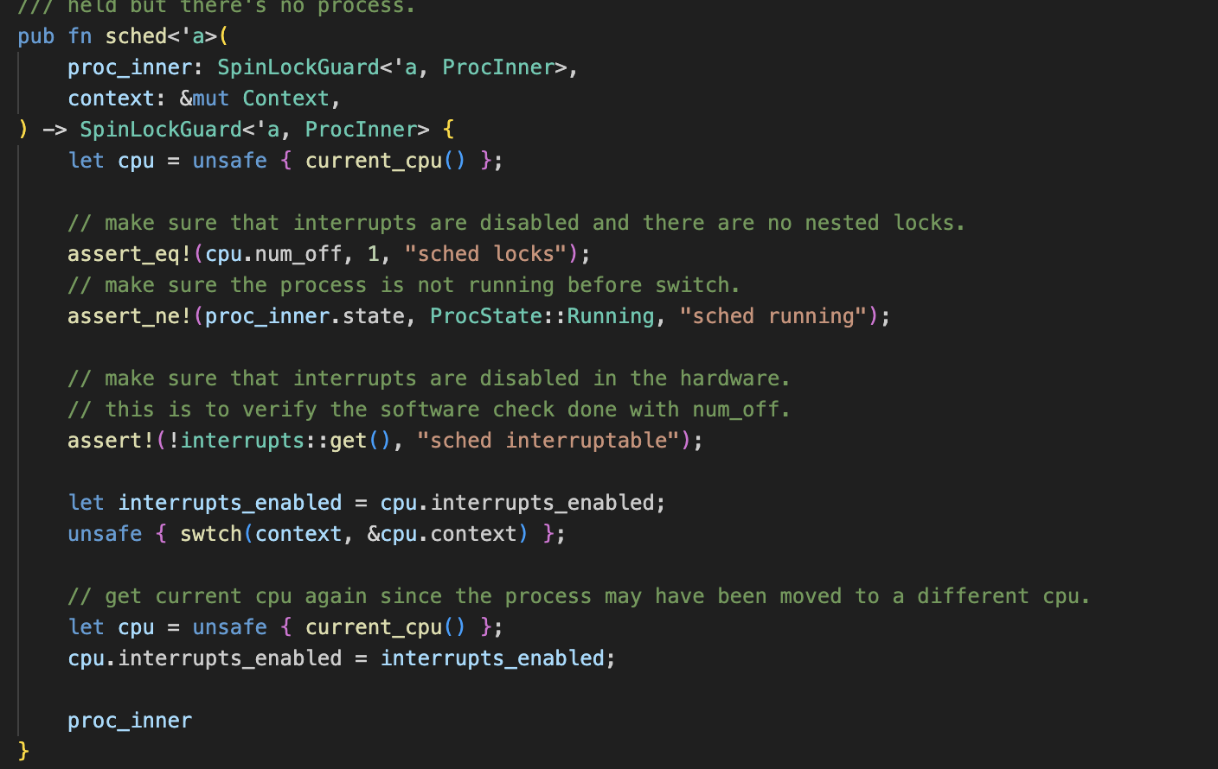
What to modify for part 2?

